Slide 1
Packet Sniffing and Spoofing
Shaoquan Jiang

Slide 2
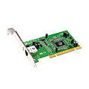
Review of Network Interface
NIC (Network Interface Card) is a physical or logical device bridging a machine and a network
Each NIC has a MAC address and is assigned an IP address
ifconfig –a
enp0s3 Link encap: Ethernet HWaddr 08:00:27:db:4e:fc
inet addr:10.0.2.15 Bcast:10.0.2.255 Mask:255.255.255.0
lo Link encap: Local Loopback
inet addr:127.0.0.1 Mask:255.0.0.0
Every NIC on the network will hear all the packets coming to it
NIC checks the destination MAC address for every packet. If this equals its own MAC address, then pass the packet to CPU; otherwise, discard it.

Slide 3
Packet Sniffer
In other words, NIC only accepts packets belonging to itself.
Packet sniffer will make NIC work differently:
NIC will pass any packet it receives to CPU.
This requires the machine to be in a promiscuous mode

Slide 4




What can be Sniffed in the Promiscuous Mode
Then, whose packets will come to the sniffing NIC?
shared cable (or hub) or shared RF: we can sniffing all sharing users.
shared wire (e.g.,
cabled Ethernet)
shared RF
(e.g., 802.11 WiFi)
shared RF
(satellite)
Notes:
Precisely, sniffer can only sniff the packets that arrive at the sniffing device. It is impossible to sniff a device far from you.

Slide 5
Normal socket
buf
Application Data
UDP Socket API
UDP header
Application Data
transport layer processing
IP header
UDP header
Application Data
IP layer processing
Ethernet layer processing
Ether header
IP header
UDP header
Application Data
Notes:
The normal sockets can only receive packets that are intended for it
It goes through TCP/IP stack and finally deliver the message to the application.

Slide 6
Limitations
The above UDP server socket only receives packets destined to the current machine.
We want to sniff packets destined to other machines.
buf for the above socket only contains application data.
UDP, IP, Ethernet headers are stripped off.
We want these headers in order to forge a responding packet.
So raw socket can overcome these issues.
Notes:
Usually, we want to make use of the packet headers in order to modify them and create some attacks. Then, the normal socket does not help. The raw socket can capture the packet of link layer. It is similar to the normal socket with different parameters.

Slide 7
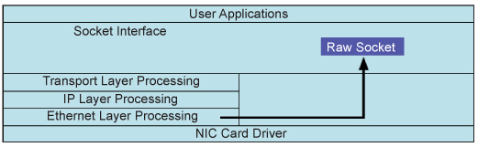
Raw Socket
Ethernet Frame
Raw Socket
Ethernet frame is directly passed to socket and further to application.
Ethernet frame include Ether header and the whole IP packet.
Ether header
IP header
UDP header
Application Data

Slide 8
Using Scapy for sniff and spoof
VM in seedlab has aready installed scapy
Use scapy in python program by adding one line:
from scapy.all import *
Scapy is written based on raw socket

Slide 9
Construct Packet
Construct IP header:
check IP fields: ls(IP())
You will see many fields such as src, dst, ttl, id … any field in the ip header.
Define IP header using keys in IP fields: myip=IP(src=“10.0.2.15”)
Construct ICMP packet:
check ICMP fields: ls(ICMP())
Similar to IP(), you will see many fields for ICMP() packet.
By default, ICMP() is an echo request packet: type=8.
define ICMP header: myicmp=ICMP(id=0x76)
Construct UDP packet is similar: you can specify sport, dport.
Form IP packet with myicmp as the payload, using operator /
pkt=myip/myicmp
Notes:
To construct packets using python Scapy package, we can run the command line script. After sudo python3,
>>From scapy.all import *
>>ls(IP()) # this will see the fields of IP header. To construct an ip header, just assign values to the fields. If you do not give values to some fields, the system will do this for you.
Important: If chksum=None in IP header or ICMP, the system will calculate the chksum for you when sending the packet out. This is useful if you want to modify some captured packets. In this case, you do not set chksum=None, it might have checksum error when sending out (you can verify this using Wireshark).
# ICMP, ARP, UDP packets can be constructed similarly.

Slide 10
Display the packet content
Check packet content:
pkt.show() # show packet without system supplied fileds (i.e., checksum)
pkt.show2() # full details of packet. We usually use this.
pkt. summary() # show the summary of the packet.

Slide 11
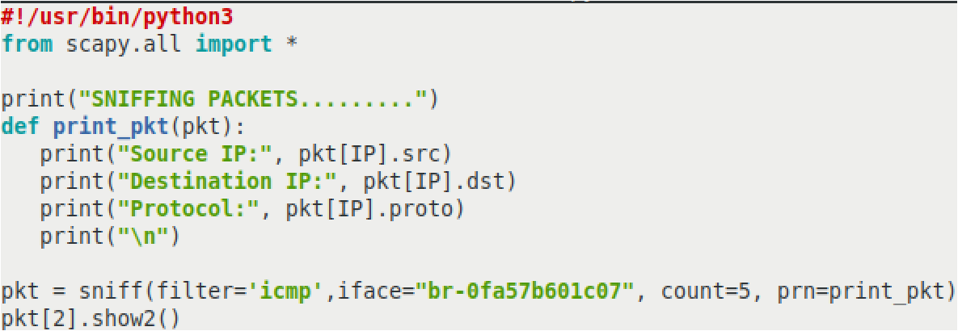
Packing Sniffing Using Scapy
sniff.py
Notes:
In this program, pkt is an array of length 5. So pkt[2] is the third captured packet. Pkt[2].show2() is to give the details of this packet, including the linker layer information.
iface is your interface that the sniffer is sniffing on. If you do not specify, it will sniff enp0s3 interface in our VM. In our docker-compose file, we create subnet 10.9.0.0/24. If you want to sniff this subnet, the iface is br-xxx. Check ifconfig in your attacker VM.

Slide 12
sniff() arguments
count: Number of packets to capture. 0 means infinity.
iface: Sniff only on the provided interface.
prn: callback function on each packet.
E.g., prn = lambda x: x.summary().
timeout: Stop sniffing after a given time in seconds (default: None).
filter: BPF filter
Ex. pkt=sniff(count=5, iface=“enp0s3”,prn=print_pkt, filter=“icmp”)
Notes:
prn is the assigned with the name of the callback function. This is the function you can define how to process the captured packet.

Slide 13
Filter expression
Use Berkeley Packet Filter (BPF) syntax, specified as follow.
type: host, net, port, portrange.
dir: transmission direction such as src, dst.
proto: protocol such as ether, ip, ip6, arp, tcp, udp.
Operators are !/not, &&/and, II/or,
Example:
1. filter_exp=“ip proto tcp && port 5500”
2. filter_exp=“host 10.0.2.6 && port 23”
3. filter_exp=“portrange 6000-6008 or net 10.0.2 or dst host 192.168.0.1”
Notes:
Check BPF.pdf for more description. For the operator, && is the same as and; ! is the same as not; or is the same as ||.
You need to know the key words: host, net, port, src, dst
When we say ip address a.b.c.d, we say host a.b.c.d for the expression.
Key words can be used in combination. For example, src host 10.0.2.1

Slide 14

pkts=sniff(filter=“icmp”)
pkts is a list of packets. E.g., pkts[1] is the second packet.
p=pkts[1] is a packet class, visualized as
access subpacket: p[Ether], p[IP], p[ICMP]
p[IP] is a shortcut of p.getlayer(IP)
p=p[Ether] is a packet class containing fields in Ether header and data field which is IP packet.
use ls(p[Ether]) to see its fields.

Slide 15
pkt=sniff(filter=“icmp”)
>>> p[IP].show() # p=pkt[1]
###[ IP ]###
version = 4
ihl = 5
tos = 0x0
len = 84
id = 452
flags =
frag = 0
ttl = 63
proto = icmp
chksum = 0xad2d
src = 192.168.0.1
dst = 10.0.2.15
\options \
###[ ICMP ]###
type = echo-reply
code = 0
chksum = 0x2683
id = 0xea7
seq = 0x1
###[ Raw ]###
load = '$Kp^F(\x05\x00\x08\t\n\x0b\x0c\...’

Slide 16
Send packet
send(pkt, verbose=0, loop=0): pkt is an IP packet
iface: # interface for packet sending.
loop: # 1 for sending endlessly and 0 for sending once
pkt # it can be one or list of packets.
verbose # 1 for display the sending information and 0 for sending siliently
sendp(frame, iface=“enp0s3”)
frame is a link layer packet, starting with Ether header (using Ether() to construct this header).
Notes:
In the assignment, you will be asked to send frame packet using sendp() and you need to set iface.

Slide 17
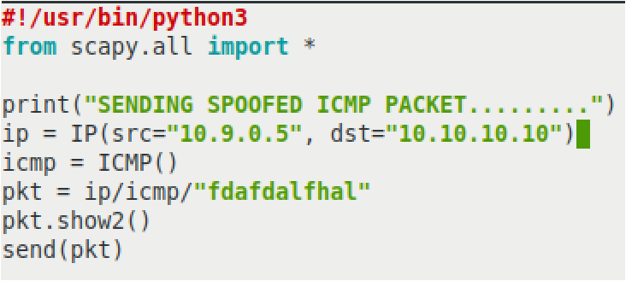
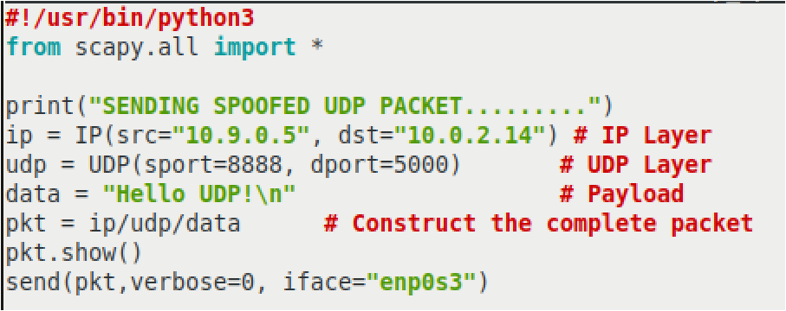
Spoofing ICMP & UDP Using Scapy
icmp_spoof.py
udp_spoof.py
Run a udp server at 10.0.2.14
$nc -lnuvp 5000
Notes:
netcat is useful command. In the nc command, l for listening, n for numeric, u for udp, v for verbose, p for port number. nc –lnuvp 5000 will create a udp server with port 5000.

Slide 18
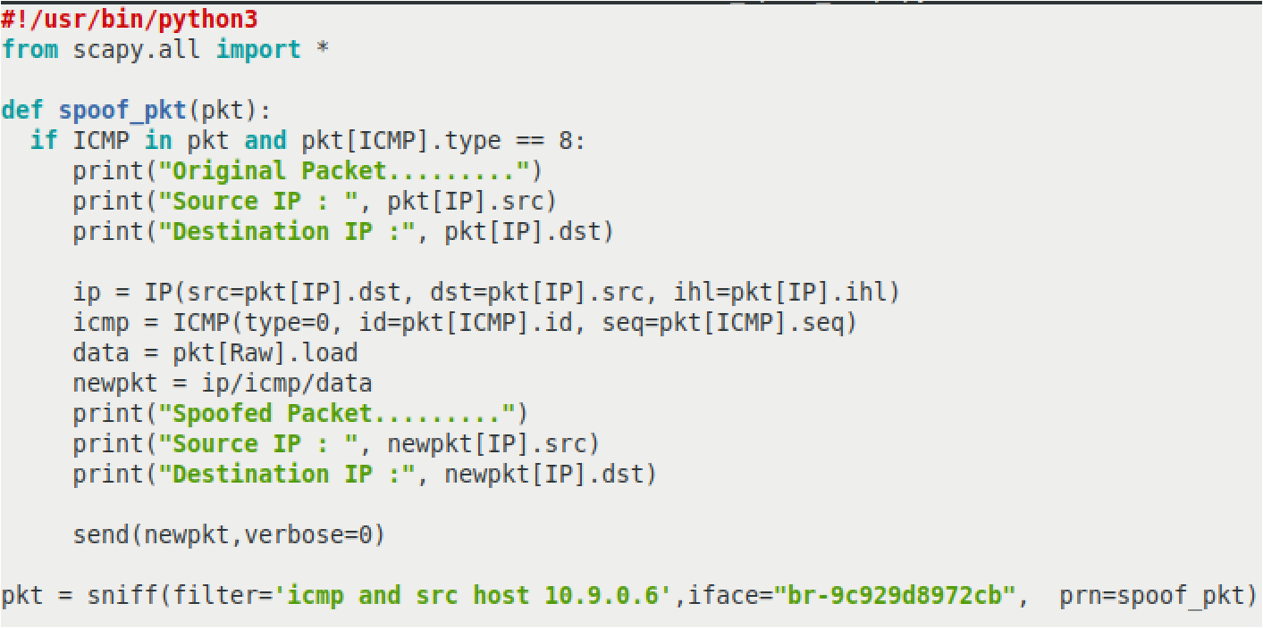
Sniffing and Then Spoofing Using Scapy
sniff_spoof_icmp.py
On 10.9.0.6:
$ping 8.8.8.8
Check what is the reply?
request
Turn on wireshark:
Which reply is from our program?
Notes:
spoof_pkt(pkt) defines the function how to process each captured packet pkt.
ICMP has type field: type 8 stands for request and type 0 stands for reply. You do not remember fields of ICMP other mentioned in the program. It has a data field (just like TCP has a data field which is application data, also like IP packet has a data field which might a TCP segment).
All IP() and TCP(), Ether(), UDP(), ICMP() are packet class. It field can be accessed. For example, if pkt=IP(dst=8.8.8.8)/ICMP(), we have pkt.dst=“8.8.8.8”.
Again, pkt[UDP] is the UDP subpacket of pkt.

Slide 19
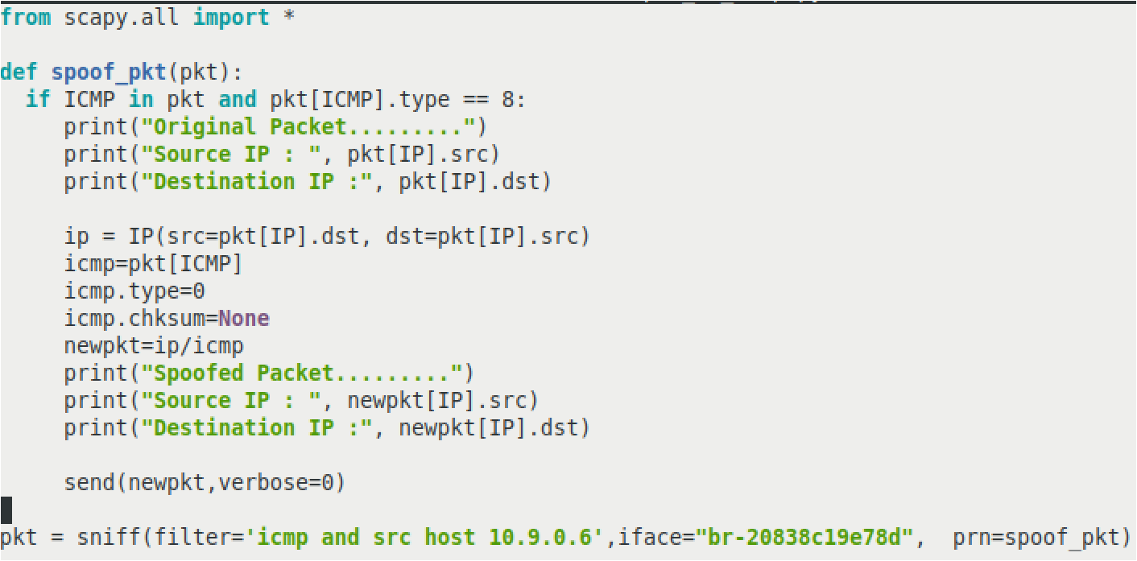
Alternative way to construct ICMP part.

